Slide 1
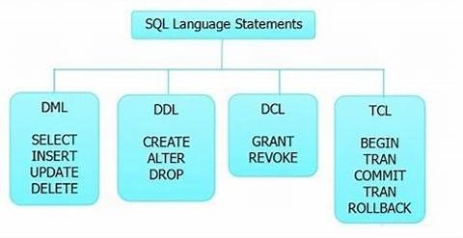
SQl
SQL commands are instructions. It is used to communicate with the database. It is also used to perform specific tasks, functions, and queries of data.
SQL can perform various tasks like create a table, add data to tables, drop the table, modify the table, set permission for users.

Slide 2
Data Definition Language (DDL)
DDL changes the structure of the table like creating a table, deleting a table, altering a table, etc.
All the command of DDL are auto-committed that means it permanently save all the changes in the database.
Here are some commands that come under DDL:
CREATE
ALTER
DROP
TRUNCATE

Slide 3
Data Manipulation Language
DML commands are used to modify the database. It is responsible for all form of changes in the database.
The command of DML is not auto-committed that means it can't permanently save all the changes in the database. They can be rollback
INSERT
UPDATE
DELETE

Slide 4
. Data Control Language
DCL commands are used to grant and take back authority from any database user.
Here are some commands that come under DCL:
Grant
Revoke

Slide 5
Case study
Financial wings Loan system
Tables
Branch table
Account manager table

Slide 6
Loan Branch
CREATE TABLE loanbranch (
account_number varchar(25)
Primary key,
branch_code varchar(25),
branch_name varchar(25),
country varchar(25),
)
.insert into loanbranch values ('BKID24001', 'IND', 'BKI01','India')
insert into loanbranch values ('BKID24002', 'AME', 'INA01','America')
insert into loanbranch values ('BKID24003', 'INO', 'MCD03','Indonesia')
insert into loanbranch values ('BKID24004', 'AME', 'INA01','America')
insert into loanbranch values ('BKID24005', 'IND', 'BKI01','India')
insert into loanbranch values ('BKID24006', 'IND', 'BKI01','India')
insert into loanbranch values ('BKID24007', 'AME', 'INA01','America')
insert into loanbranch values ('BKID24008', 'INO', 'MCD03','Indonesia')
insert into loanbranch values ('BKID24009', 'IND', 'BKI01','India')
insert into loanbranch values ('BKID24010', 'IND', 'BKI01','India')
select * from loanbranch

Slide 7
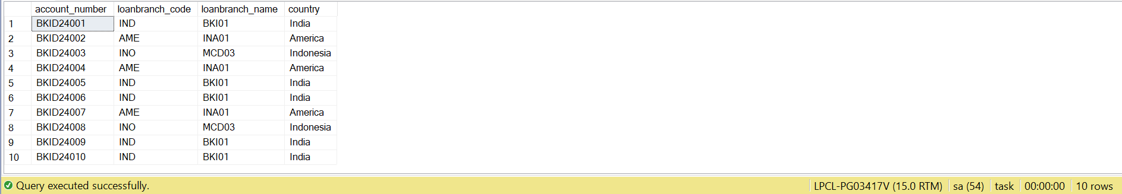
Loan Branch table

Slide 8
Account manager
CREATE TABLE Account_manager(
MID int Primary key,
userid int,
Mname varchar(250),
MContact int ,
email varchar(250),
Branchcode varchar(250),
Address varchar(250),
opendate date
)

Slide 9
Insert data
insert into Account_manager values ('1',101, 'Muskan', 8263000,'muskan@gmail.com','IND', 'delhi', '2004-12-16')
insert into Account_manager values ('2', 102,'Shakshi',6345600000,'shakshi@gmail.com','AME','newyork', '2008-12-15')
insert into Account_manager values ('3',201, 'Rahul', 80325000, 'rahul@gmai.com','IND', 'bhopal','2006-08-20')
insert into Account_manager values ('4', 103,'Nikita', 765100000, 'nikits@gmail.com','AME','newyork', '2007-12-16')
insert into Account_manager values ('5',104, 'Anshu', 987120000, 'anshu@gmail.com','AME','newyork','2008-12-25')
insert into Account_manager values ('6', 105,'Era', 98500000, 'era@gmsil.com','IND','delhi','2005-07-27')
insert into Account_manager values ('7',106, 'Meghana', 93400000,'meghna@gmail.com','AME','newyork','2009-12-12')
insert into Account_manager values ('8',107, 'Rashika', 90300000, 'rashika@gmail.com','IND','delhi','2009-12-12')
insert into Account_manager values ('9',111, 'Mansi', 92400000, 'manshi@gmail.com','AME','newyork','2012-09-17')
insert into Account_manager values ('10',108, 'Mohit', 95460000,'mohit@gmail.com','IND','delhi','2013-04-18')
select * from Account_manager

Slide 10
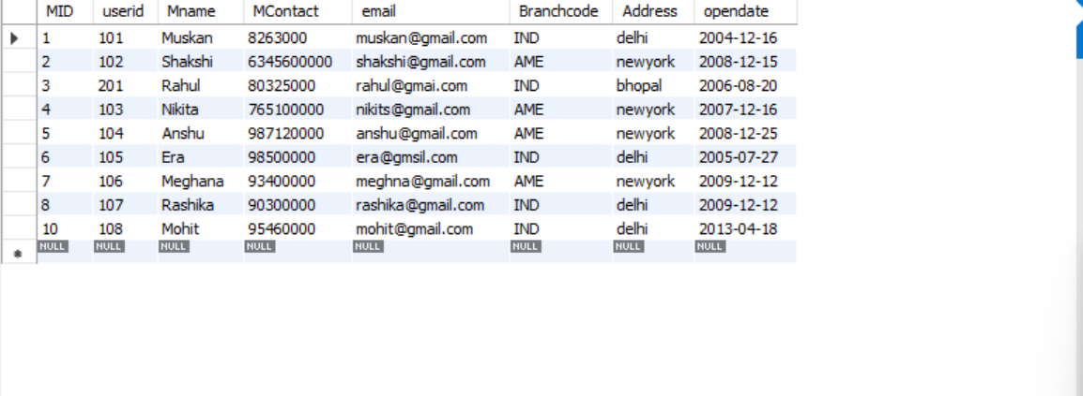
Account manager table

Slide 11


